Slide 1
ANTI PESTO
A web application for Agricultural Improvement

Slide 2
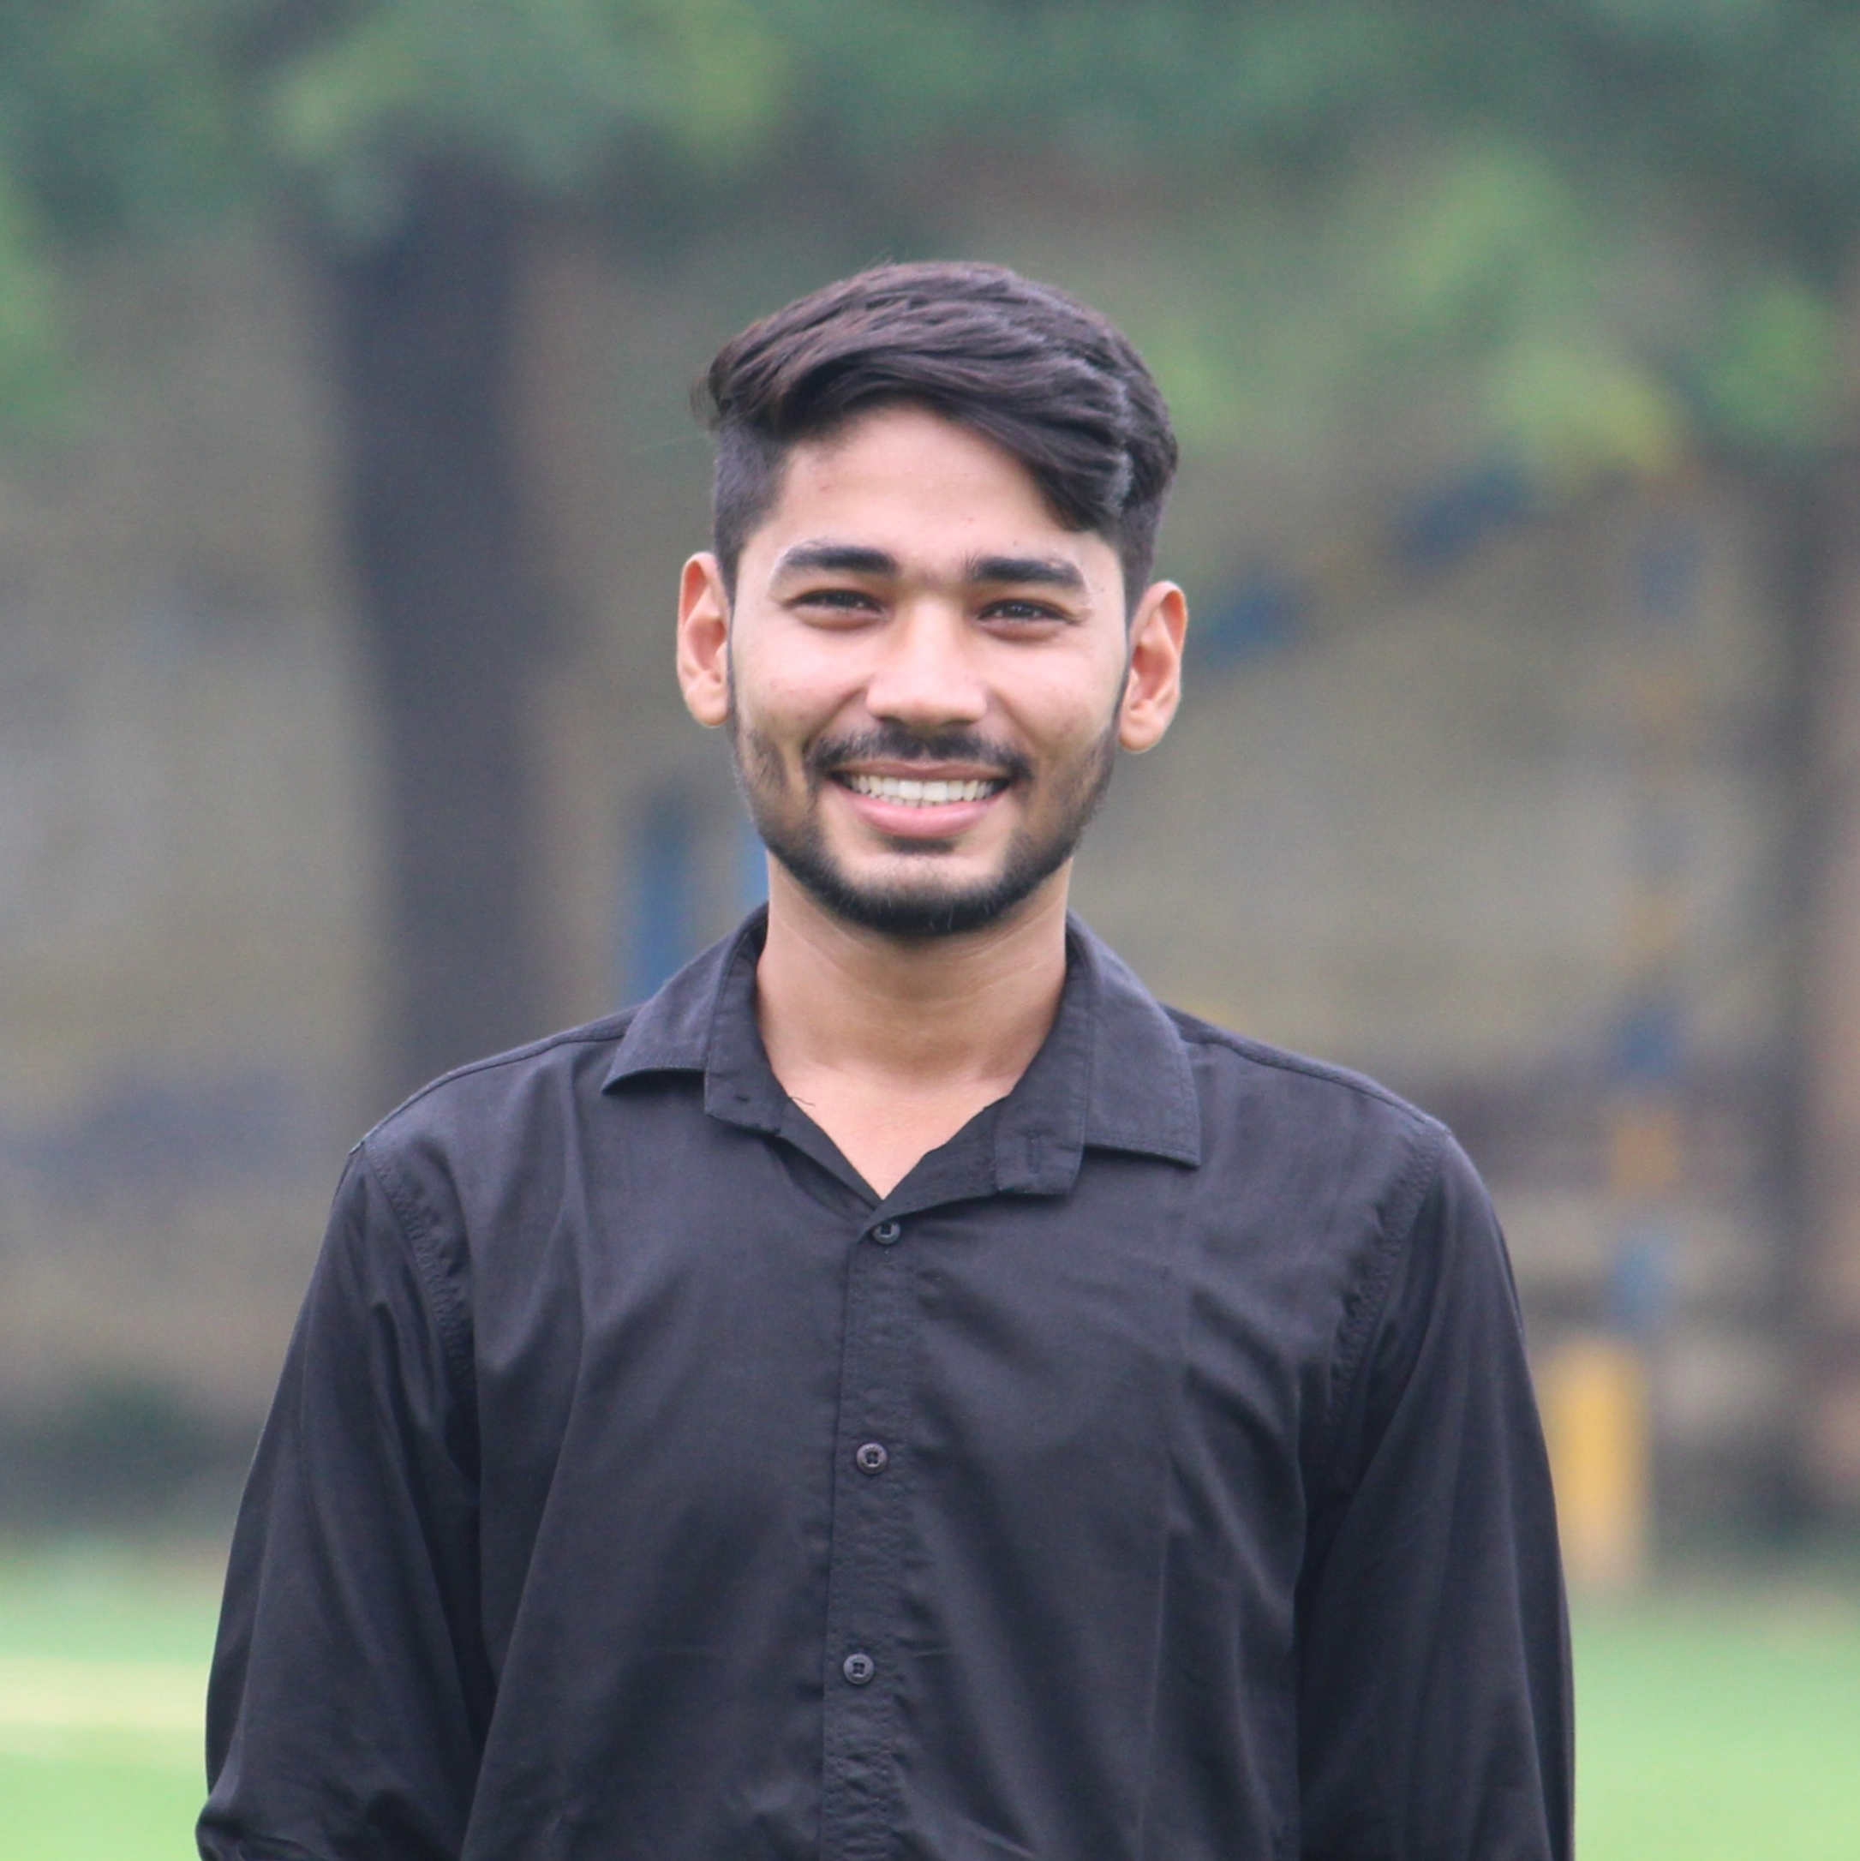

OUR TEAM
Madhav Sharma
Navneet chaudhary
2200290140083
2200290140097

Slide 3
introduction
It is a Project to help farmers.
By preventing their crops from harmful insects and pests.

Slide 4
India ranks second worldwide in farm outputs. As per the Indian economic survey 2020 -21, agriculture employed more than 50% of the Indian workforce and contributed 20.2% to the country's GDP.
“
”

Slide 5




Software requirements
My sql
bootstrap
Vs studio
xampp

Slide 6
modules
User Management Module
Admin Panel
Crop Management
Pests and Disease Management
Government Schemes
Forms and Queries

Slide 7
AREAS OF FOCUS
Identification of pests BY Users
Prevention methods
Identification of the respective pest or insects will be done by matching the type of damage occurred in the crops with our database.
If it matches then users can get preventive methods from our web application.
Prevention methods will be mentioned for the protection of crops.
Users can choose any method according to their comfort.

Slide 8
summary
The system will feature a user-friendly front-end interface developed using HTML and CSS. This interface will allow users to easily navigate their problem of crops, making it accessible their solutions.

Slide 9
THANK YOU

